Slide 1



Design of Software Systems
Introduction to C#
Assoc. Prof. Dr. Marco Kuhrmann, Maximilian Irlbeck
Elena Markoska
Mads Norby
Martin Dreymann

Slide 2

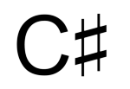
Agenda
- Introduction to C#
- Language design
- Language features and syntax
2!

Slide 3


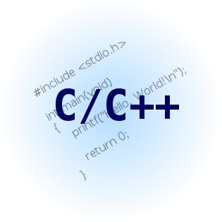






C# - General information
- C# was influenced by
§▪ Java
§▪ C/C++
§▪ Pascal/Delphi
§▪ Haskell
§▪ Modula-3
§▪ Visual Basic
- C# supports the following IDEs:
§▪ Microsoft Visual Studio 2003, 2005, 2008,
2010, 2012, 2013
§▪ SharpDevelop
§▪ MonoDevelop
§▪ XNA Game Studio
§▪ C#-Builder
§▪ Baltie
3!

Slide 4
LANGUAGE DESIGN AND TYPE SYSTEM
Design of Software Systems – Introduction to C#
4!

Slide 5
Types in C#
- C# is a strong-typed, object-oriented programming language
- Two kinds of types:
§▪ Reference Types (class, interface, delegate, arrays, …)
§▪ Value Types (struct, enum, base types, …)
- Every type is per se a child class of object, i.e. all types implement the standard method from object (e.g., ToString())
- Note: for reference types exists a special type:
null – the “empty” reference
5!

Slide 6
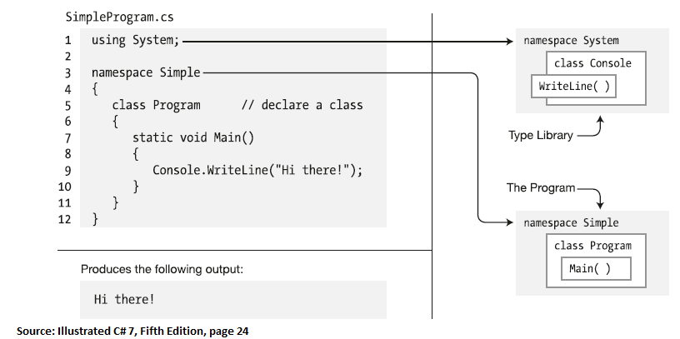
Java and C#
Generally, if you know Java, it is easy to learn C#
A (very simple) C# main class:
6!

Slide 7
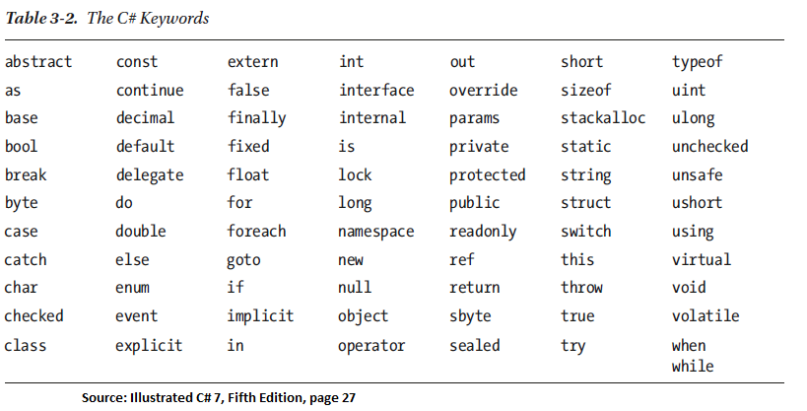
C# Keywords
Most are similar to Java. Some are different and/or new.
7!

Slide 8
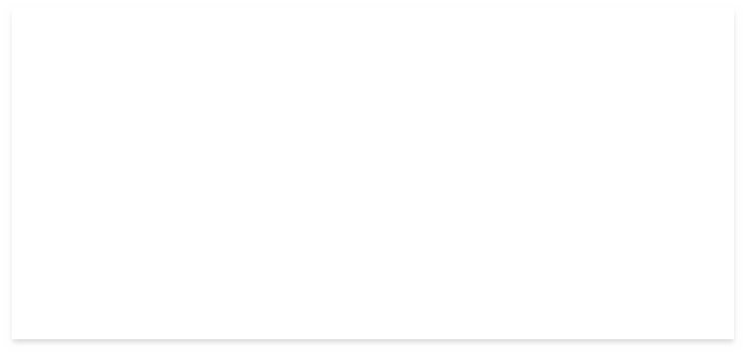


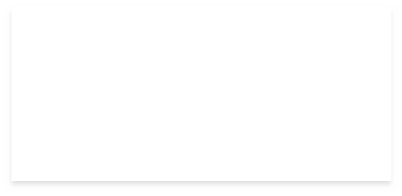




Boxing/Unboxing
Value types can be stored in “real” objects (reference types): casting
object o = (object)3;!
object
o
3
Boxing
int i = (int)o;
i = 3
Unboxing

Slide 9
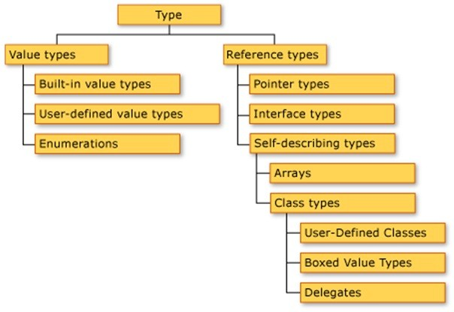
Value Types

Slide 10
Value types: base types
Data Type | Range | Size in Bits | .NET Runtime type
bool | true oder false | 1 | System.Boolean
byte | 0 … 255 | 8 | System.Byte
sbyte | -128 … 127 | 8 | System.SByte
char | 0 … 65535 | 16 | System.Char
short | -2¹⁵ … 2¹⁵ -1 | 16 | System.Int16
ushort | 0 … 65535 | 16 | System.UInt16
int | -2³¹ … 2³¹ -1 | 32 | System.Int32
uint | -32.768 … 32.767 | 32 | System.UInt32
float | 1,4 x 10⁻ ⁴⁵ … 3,4 x 10³⁸ | 32 | System.Single
ulong | 0 … 2⁶⁴ -1 | 64 | System.UInt64
long | -2⁶³ … 2⁶³ -1 | 64 | System.Int64
double | 5,0 x 10⁻ ³²⁴ … 1,7 x 10³⁰⁸ | 64 | System.Double
decimal | ±1,0 x 10⁻²⁸ … ±7,9 x 10²⁸ | 128 | System.Decimal

Slide 11

Base types – examples
1 | uint u = 6;
2 | int i = -10;
3 | byte b = 0x01; | // | Hexadecimal
4 | float f = 4.0F;
5 | double d = 0.5D;
6 | double d2 = 0.5F;
7
8 | char c1 = 'Z'; | // | Character literal
9 | char c2 = '\x0058'; | // | Hexadecimal
10 | char c3 = (char)88; | // | Cast from integral type
11 | char c4 = '\u0058'; | // | Unicode
12 | char c5 = '\t'; | // | Special character
13
14 | decimal d = 440.5m; | // | m for Money! (.. Becuase double already used ”d”)

Slide 12

Value types – enumerations
1
2
3
4
5
6
7
8
9
enum DaysOfWeek : byte // any integer type works (e.g. long)
{
Monday = 1, // standard: 0-indexed, now 1-indexed
Tuesday, Wednesday, Thursday, Friday, Saturday, Sunday
// = 2
// = 3
// = 4
// = 5
// = 6
// = 7
10 };
11
DaysOfWeek today = DaysOfWeek.Thursday;
int today = (int)today; // today = 4

Slide 13
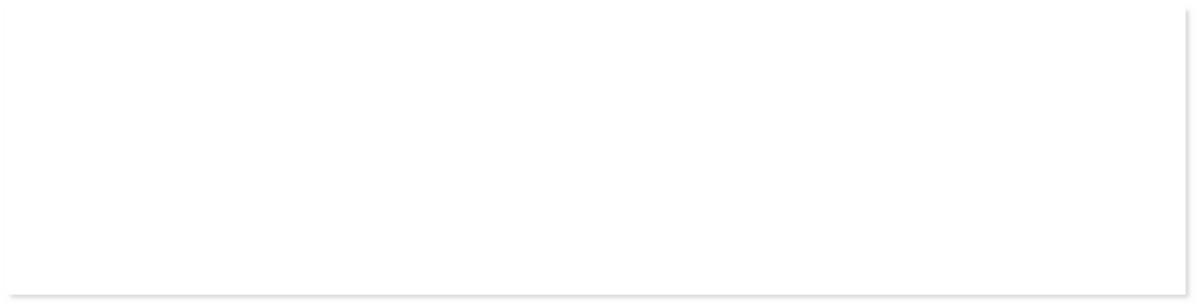
Value types – structures
1 public struct Circle 2 {
public double radius;
public double centerX;
public double centerY; 6 }
- Structs can also implement:
§▪ Constructors, Methods, Operators, Events
§▪ Constants, Fields (variables), Properties, Indexers
§▪ Nested types
- Structs can also implement an interface, but they cannot inherit from another struct. That is, member of a struct cannot declared protected.

Slide 14
Reference Types

Slide 15



Types: Arrays
int[] myInts = new int[10];
int[] myInts = new int[10]{0,0,0,0,0,0,0,0,0,0};
32 Bit
Value | 0 | 0 | 0 | 0 | 0 | 0 | 0 | 0 | 0 | 0
Index | 0 | 1 | 2 | 3 | 4 | 5 | 6 | 7 | 8 | 9
myInts[2] = 255;
Value | 0 | 0 | 255 | 0 | 0 | 0 | 0 | 0 | 0 | 0
Index | 0 | 1 | 2 | 3 | 4 | 5 | 6 | 7 | 8 | 9
myInts[7] = myInts[2] - 1;
Value | 0 | 0 | 255 | 0 | 0 | 0 | 0 | 254 | 0 | 0
Index | 0 | 1 | 2 | 3 | 4 | 5 | 6 | 7 | 8 | 9

Slide 16
Types: Strings
Strings are…
- “Special” reference types
- Strings are composed of Unicode characters, and are “constant”
string s =
"This is a string."
T | h | i | s |  | i | s |  | a |  | s | t | r | i | n | g | .
s
s += ".."
s
- Equivalence (== and !=) of Strings is not evaluated via reference identity, but by comparing the values of the strings
- Note: difference to Java; implemented using operator overloading
T | h | i | s |  | i | s |  | a |  | s | t | r | i | n | g | .
T | h | i | s |  | i | s |  | a |  | s | t | r | i | n | g | . | . | .

Slide 17

Types: Classes
1 public class Foo : FooBase, ICloneable 2 {
3
4
5
6
7
8
9
10
11
12
13
Inheritance list
private int myInt = 0;
Fields
public int MyInt
{
get { return myInt; } set { myInt = value; }
}
Properties
internal Foo()
{
Constructors
}
14 …
15
16
17
18
19 }
protected void AddToMyInt(int num)
{
myInt += num;
}
Methods
20!

Slide 18

Constructing and using objects
1
2
3
4
5
6
7
8
9
10
11
Foo f = new Foo();
Constructor call
f.MyInt = 1337;
Property assignment
Foo g = new Foo();
Constructor call
g.AddToMyInt(10);
Method call
Property assignment
f.MyInt = g.MyInt;
System.Console.WriteLine(f.MyInt);
Output
→ Output: 10

Slide 19
C# language conventions for identifiers
PascalCase
- Classes
- Interfaces
- Events
- Structures
- Properties
- Enumerations
- Enumeration values
camelCase
- Fields
- Parameters
- Local variables
UPPERCASE
- Constants
- Identifiers with <= 2 letters (mostly used for namespaces, e.g., System.IO)

Slide 20
Code organization – Namespaces !
All code is organized in Namespaces: A namespace is a hierarchical logical structure of code and libraries. A namespace is qualified and accessed using the Scope Operator (“.”).
Note: Namespace ≠ Assembly!
Example: System.DateTime
= Namespace
System.Xml.XmlDocument
System.Xml.Serialization.XmlSerializer
Import/access a namespace with the keyword using.

Slide 21

Code organization – files !
- Code is stored in *.cs files.
- Conventions (Note: it’s not a physical restriction)
§▪ One file per class/structure
§▪ Class name = file name
§▪ File system structure = namespace structure
- Special case:
using the keyword partial, classes can be split across several files.
Class x
file1.cs
file2.cs
file3.cs

Slide 22
LANGUAGE FEATURES AND SYNTAX
Design of Software Systems – Introduction to C#

Slide 23






















Hello World in C#
Import
1
2
3
4
5
6
7
8
9
10
11
12
13
using System;
namespace
Define a namespace
namespace HelloWorld
{
public class HelloWorldClass
{
Class name
The Main() method
static void Main(string[] args)
{
// Show yourself to the world outside Console.WriteLine("Hello World!");
}
Method arguments
comment
}
Static method call; here: write a string to the console
14 }

Slide 24
Accessibility levels in C# - visibility
Level
Visibility/accessibility
public
Globally visible
internal
Visible in the same assembly (physical grouping)
protected
Visible in the inheriting class
internal protected
Visible in the inheriting class in the same assembly
private
Visible in the class only

Slide 25
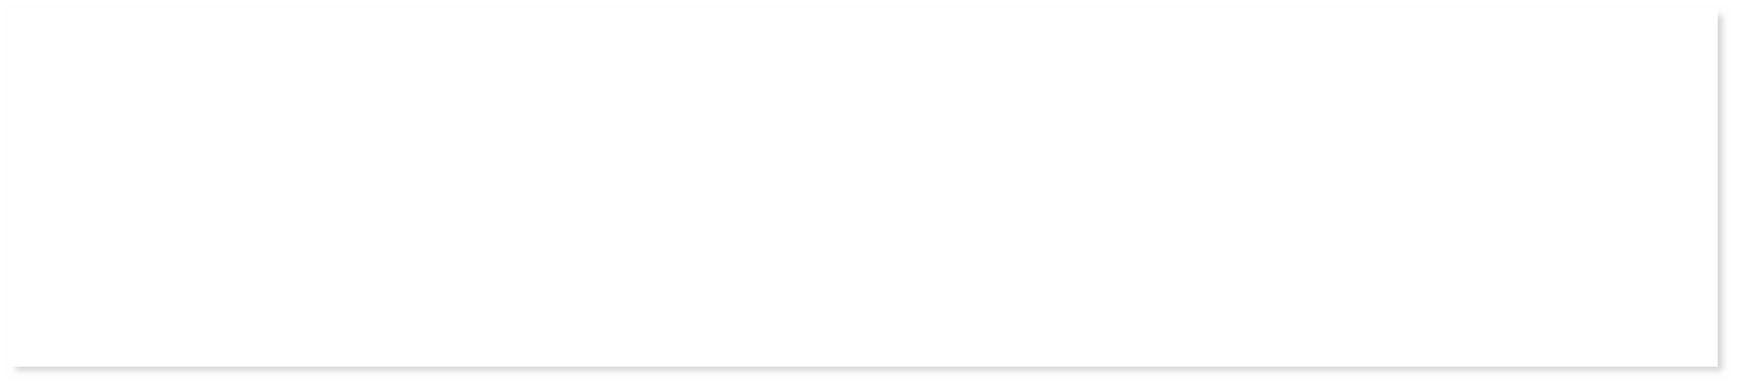
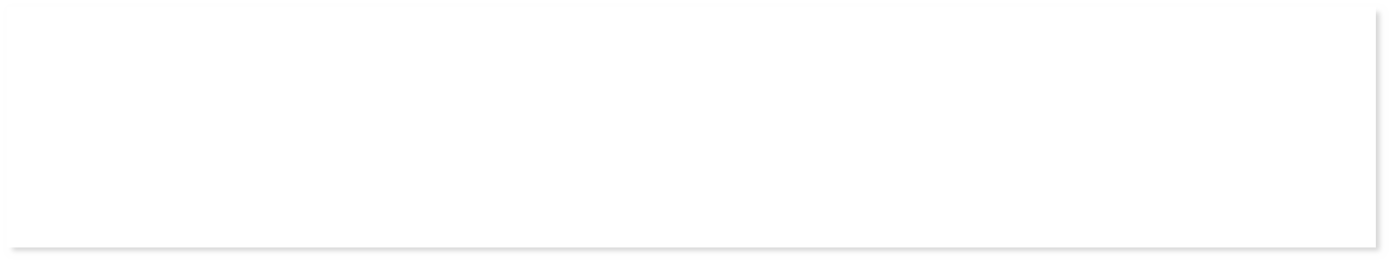
Methods
/// <summary> Documentation </summary>
<visibility> <return type> <Name>(<Parameters>)
{
// implementation
}
For example...
1
2
3
4
5
6
public static string Sort(string input)
{
char[] arr = input.ToCharArray(); Array.Sort(arr);
return new string(arr);
}
1 internal static void CaesarCipher(char[] charArray) 2 {
3
4
₅ }
for (var i = 0; i < cArray.Length; i++)
{ cArray[i] = (char)(cArray[i] + key); }

Slide 26

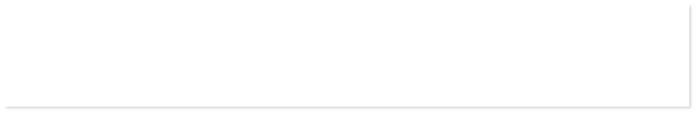
Methods: example – find the maximum
1 public int Max(int first, int second) 2 {
3 if (first >= second) 4 {
5 return first;
6 }
7 else
8 {
9 return second; 10 }
11 }
1 public int MaxFunctional(int first, int second) 2 {
3 return first >= second ? first : second; 4 }

Slide 27






Scopes
1
2
3
4
5
6
7
8
9
10
11
public class Foo
{
private int myInt = 0;
public void DoSomething()
{
int localVar = 1; if(myInt == 0)
{
string s = „Hello World“;
}
}
myInt
localVar
s
12 }
30!

Slide 28

Delegates
- Refer to methods (so-called method pointer)
- Have a defined signature
- In C# used for, e.g., events and asynchronous method calls
delegate string MyStringDelegate(string input);
1
2
3
4
5
6
7
8
9
10
11
12
public string LowerFunction(string inputStr)
{
return inputStr.ToLower();
}
public void OtherFunction(string someString)
{
MyStringDelegate lowerDelegate = LowerFunction; lowerDelegate(someString); // Calls LowerFunction(someString)
}

Slide 29

Interfaces in C#
1 public interface INumberable // Just an example interface. 2 {
int Number { get; set;}
string NumberToString(); 5 }
6 public class NumerableImplementation : INumberable 7 {
private int number = 0;
public int Number
10 {
get { return number ; }
set { number = value; } 13 }
14 public string NumberToString() 15 {
16 return number.ToString(); 17 }
18 }

Slide 30
Conditional execution and branching
bool lazy = true; |  |  | DaysOfWeek day = DaysOfWeek.Wednesday;
bool bored = true; |  |  | // Typical week of a student
 |  |  | switch (day)
if (lazy) |  |  | {
{ |  |  | case DaysOfWeek.Saturday: goto case DaysOfWeek.Sunday;
// I‘m lazy |  |  | case DaysOfWeek.Sunday:
} |  |  | Sleep(); Eat(); Chill(); Sleep();
else if (bored) |  |  | break;
{ |  |  | default:
// I‘m not lazy | but | bored | Sleep();
} else { // I‘m not lazy & not bored } |  |  | GoToLecturesAndSleep(); EatAtCafeteria(); GoToLecturesAndSleep(); ChillOrParty(); Sleep(); break; }

Slide 31
Loops
while (feelingLikeParty)
{
// The Party Loop. DrinkABeer();
}
for (int i = 0; i < 100; i++)
{
// Write a hundred times...
Console.WriteLine(„I will not vote for Donald Trump!");
}
do
List<string> seminarList =
new List<string>(){„Timm“, „Dominik“, ..};
{
/* always drink at least one beer */
DrinkABeer();
foreach (string name in seminarList)
{
// Say hello to everyone! Console.WriteLine(„Hello {0}.“ , name);
}
}
while (feelingLikeParty);
break continue
exit the whole loop
skip one cycle of the loops

Slide 32
Operators in C#
- Comparison
== Equivilance
!= Not equivalent
<, >, <=, >= Less than, greater than, less or equal, greater or equal
- Logical operators
! && |  |  | NOT (unary negation) conditional AND
|| |  |  | conditional OR
- Type checking and type casts!
is, typeof
type compatibility, type exploration
Cast (checked)
Cast (unchecked, in case of an error, an exception is thrown)
as
(<Typ>)

Slide 33
Operators in C#
- Arithmetic operators
+, -, *, / basic maths
++, --
increment, decrement (pre- or post-)
modulo operation
%
- Access- and assignment operators
[<Index>]
access an indexed data structure
(value) assignment
combined (value) assignment
=
+=, -=,*=
- Bit operators
<<, >>
&, |, !, ^
bit shifting
bit-wise logical AND, OR, NOT, XOR

Slide 34
Operator overloading
Syntax:
public static <result type> operator <Operator> (<Operand1>, <Operand2>)
Examples:
public static bool operator >=(GeometricObject geoObj1, GeometricObject geoObj2)
{
if(geoObj1.GetArea() >= geoObj2.GetArea()) return true;
return false;
}
// Special case: Indexer Properties public T this[int i] {
get { return arr[i]; } set { arr[i] = value; }
}

Slide 35
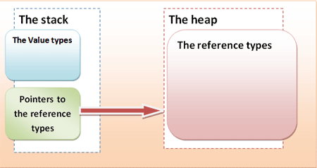
The small difference: reference- and value types
Value types
A value type is stored on the stack. Hence, an explicit instantiation to create an instance (as a variable) is not necessary. An assignment of a variable always creates a copy of the value; if variables of a value type are compared, the identity of the value is tested.
Reference types
A reference type is stored on the heap, the stack only contains a reference to the respective memory address in the heap. To use an instance (create a variable), it is required to instantiate a reference type. An assignment only creates a copy of the pointer; if variables are compared, the identity of the pointers is tested.
10!
Source: https://www.c-sharpcorner.com/UploadFile/yougerthen/what-really-make-difference-between-structures-and-classes/

Slide 36
Generics
Generic classes:
class GenericClass<T> where T : IComparable
{
T member; // T will implement IComparable
…
}
Generic methods:
U GenericMethod<T,U>(T input) where T : new()
{
T tVal = new T(); // Cool, I’m able to create T!
…
}

Slide 37
Tips for the practical route to C#!
The best way to learn a programming language is using it
Online training material for free:
- http://msdn.microsoft.com/en-us/library/aa288436(v=vs.71).aspx!
- http://www.csharp-station.com/Tutorial/CSharp/
- http://www.introprogramming.info/english-intro-csharp-book/videos/
- http://simple.wikipedia.org/wiki/C_Sharp_(programming_language)
- http://channel9.msdn.com/Series/C-Sharp-Fundamentals- Development-for-Absolute-Beginners
- http://www.tutorialspoint.com/csharp/index.htm
40!

Slide 38
Exercise
Get familiar with the code
Seperate the code into a more appropriate design
Remember to handle execeptions properly
Keep high coherence and low coupling
Switch code with a person next to you and review each others code
What works well?
What could be designed more appropriately?
Implement new feature:
Have the server exit, when the client exits
Use the directions provided in the lab description to run the .cs files
Besides the methods provided, you can download mono and use it to compile
And execute the .cs files in the commandline
https://www.mono-project.com/download/stable/ (Install on OSX)
https://kozmicluis.com/compile-c-sharp-command-line/ (Run C# from commandline in OSX and windows)
41!

